Slide 1
Graphene and Micro-supercapacitors
RET is funded by the National Science Foundation, grant # EEC-1404766.
Key Concepts Relating to
Project 2: Synthesis and Characterization of Graphene for Energy Storage Devices
John D’Alessandro
Mike Day
Notes:
Show slide… Mike says subject; John introduces Self; Mike introduces Self

Slide 2
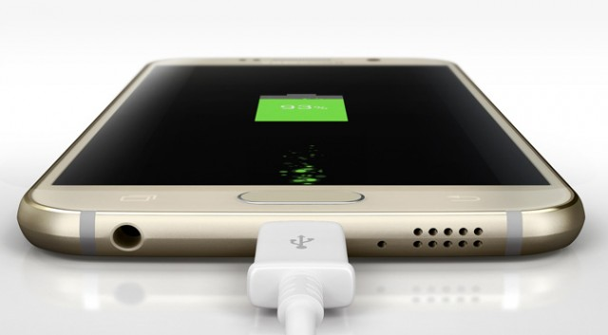
Does your phone take too long to charge?
Image source: ExtremeTech
Notes:
Mike does it!

Slide 3
Table of Contents
Abstract
Introduction
Background Literature Review
Goals and Objectives
Research Training Received
Unit Topic, Essential Question and Challenge
Progress

Slide 4
Abstract
Synthesize Graphene Papers With Varying Characteristics
Build Micro-supercapacitors From Graphene Papers
Analyze The Quality Of The Supercapacitors
Make Classroom Units In Math And Physics Based Off Of Our Work
Notes:
Flash and go

Slide 5
Introduction
Micro-supercapacitors Using Graphene Paper Are
Fast charging
Energy dense
Flexible
Notes:
Mike

Slide 6
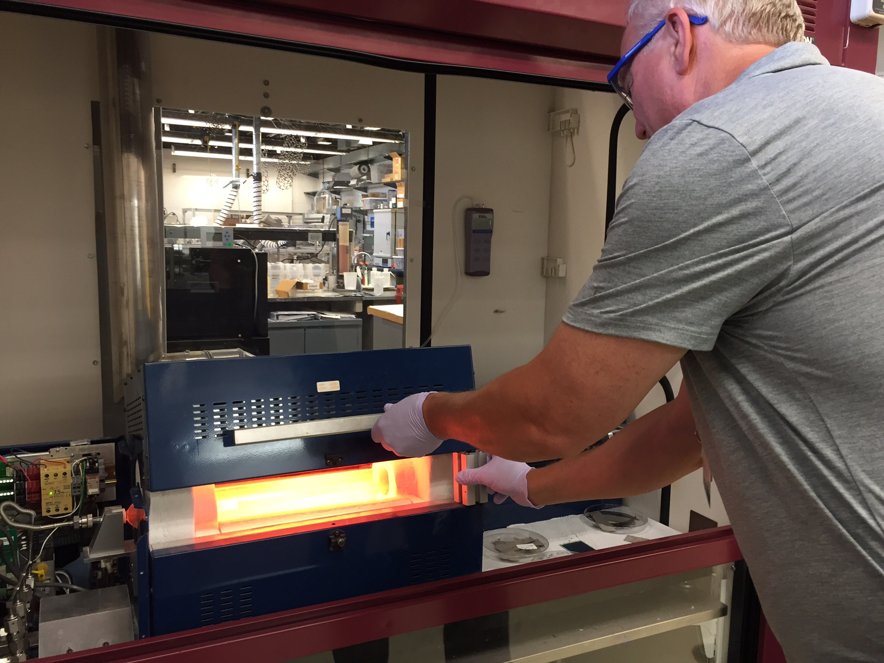
What Do You Need to Know???
Graphene
Micro-supercapacitor
Notes:
Mike

Slide 7
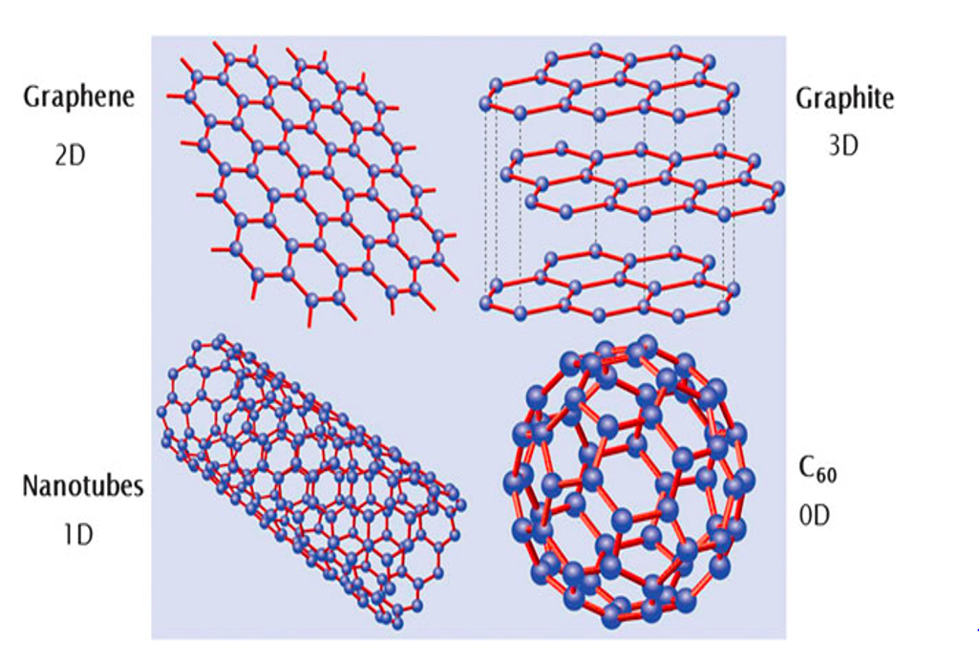
Graphene is a Type of Carbon Structure
0-Dimensional
Bucky Balls
1-Dimensional
Carbon Nanotubes
2-Dimensional
Graphene
3-Dimensional
Graphite
Notes:
Mike

Slide 8
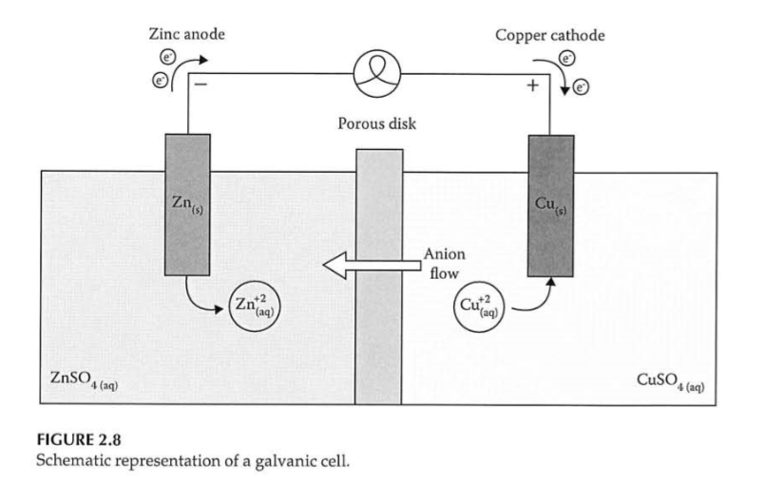
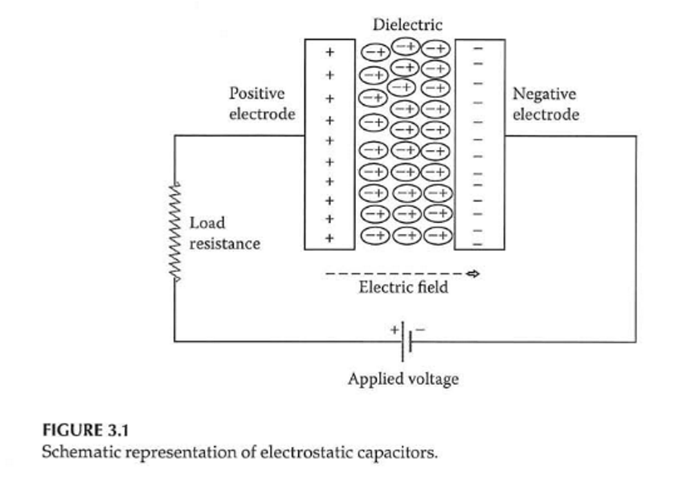
Micro-supercapacitor: Batteries and Capacitors
Batteries Use Redox Reactions
Capacitors Store Static Charge
(Balakrishnan and Subramanian, 2014, pp. 30 and 43 )
Notes:
John blows through this

Slide 9
Supercapacitors and Micro-supercapacitors
Capacitance
Electric Double Layer Capacitance
Pseudo-capacitance
(Balakrishnan and Subramanian, 2014, pp. 45)
Notes:
John blows through this

Slide 10
Supercapacitors
Advantages
Unlimited cycle-life
High Specific Power
Charges Easily
Charge and Discharge at Low Temperature
Limitations
High self-discharge
Low Specific Energy
Low Cell Voltage
High Cost
Notes:
John highlights only temperature and cost here QUICKLY

Slide 11
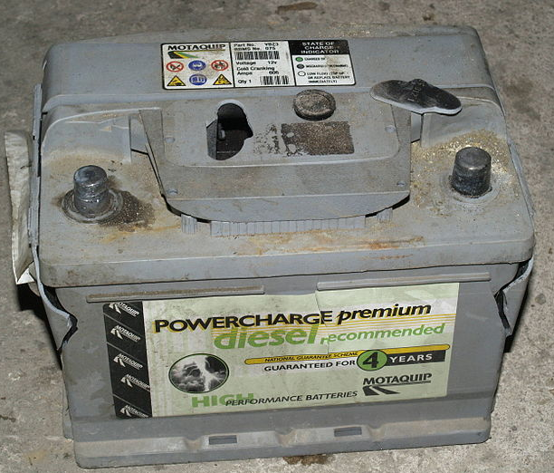
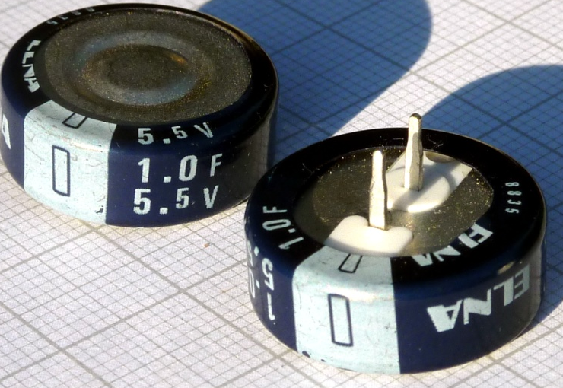
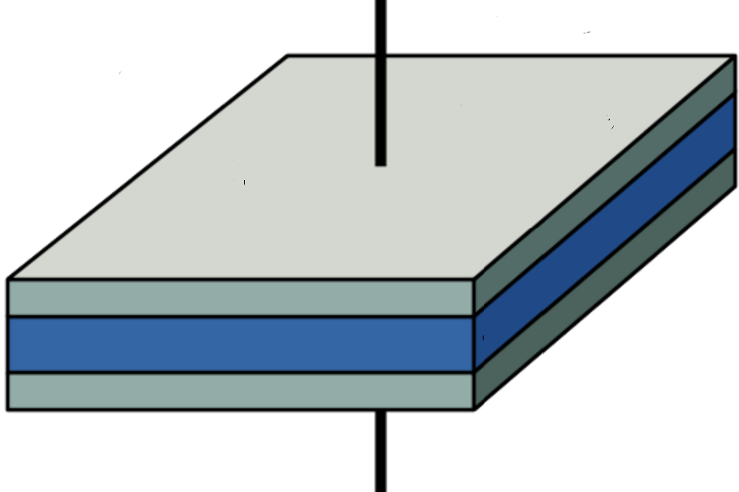
Comparison of Performance
(Balakrishnan and Subramanian, 2014, pg. 64 )
Notes:
John talks about performance difference quickly.

Slide 12
Charge/Discharge Curves

Slide 13
Impedance Testing

Slide 14
Why Are We Here???
What Are Our Goals, Objectives and Our Tasks in This Awesome Research Project???
Notes:
John blows through this

Slide 15
Goals Objectives
In-lab Research
Manufacture 3-D Graphene Micro-supercapacitor
Improve Performance
Develop Our Units
Learn To Synthesize, Characterize Graphene, And Test Device Properties
Write Report
Apply Units In Classes
Notes:
Mike

Slide 16
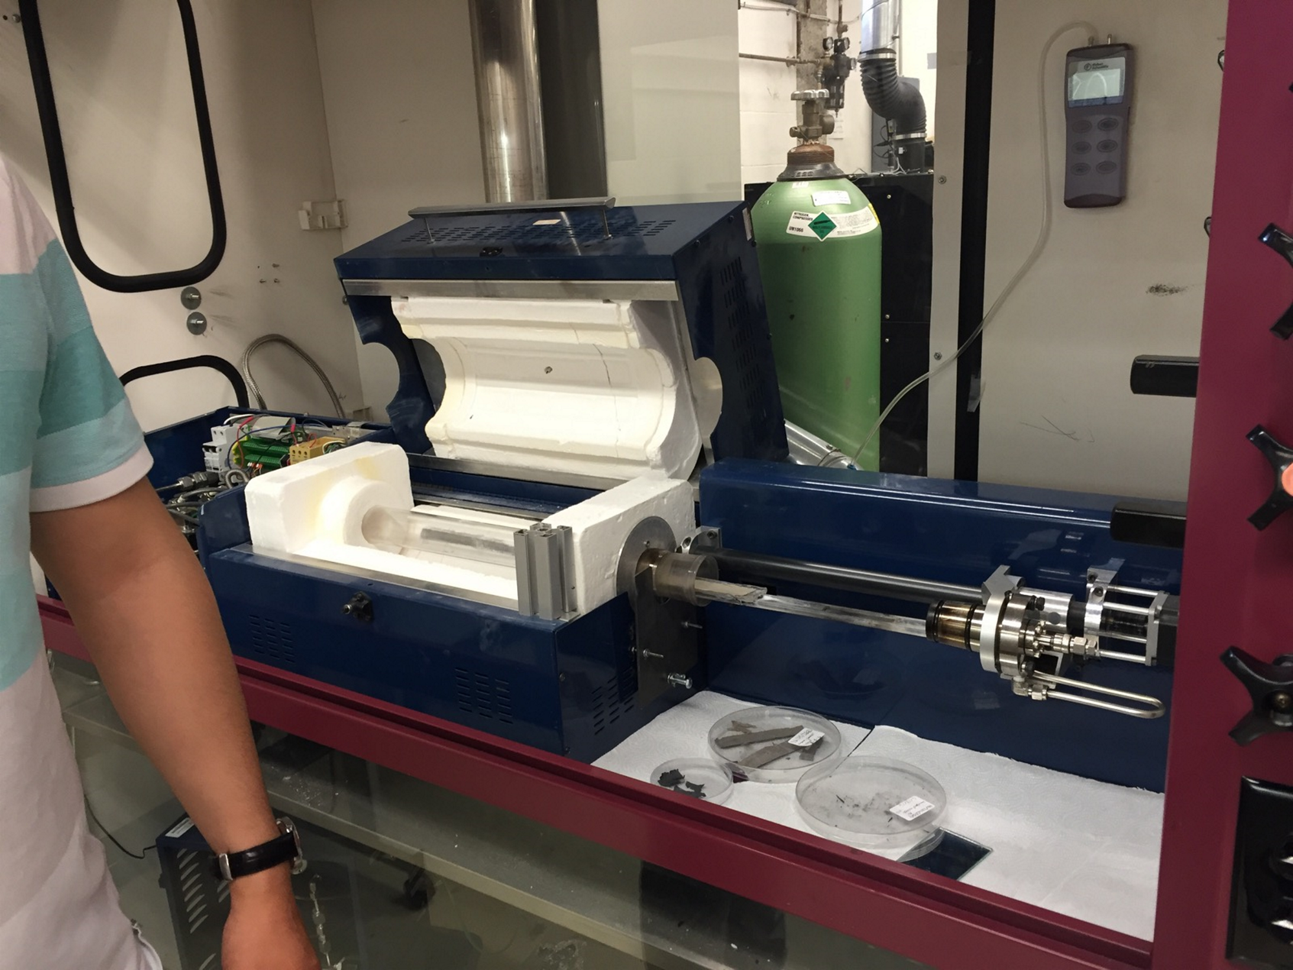
How to Manufacture a Graphene
Micro-supercapacitor (G1, O1)
1. Synthesize the Graphene
2. Characterize the Graphene
3. Manufacture
Micro-supercapacitor
Notes:
These are our research steps… Mike says them Leads into our Tasks...

Slide 17
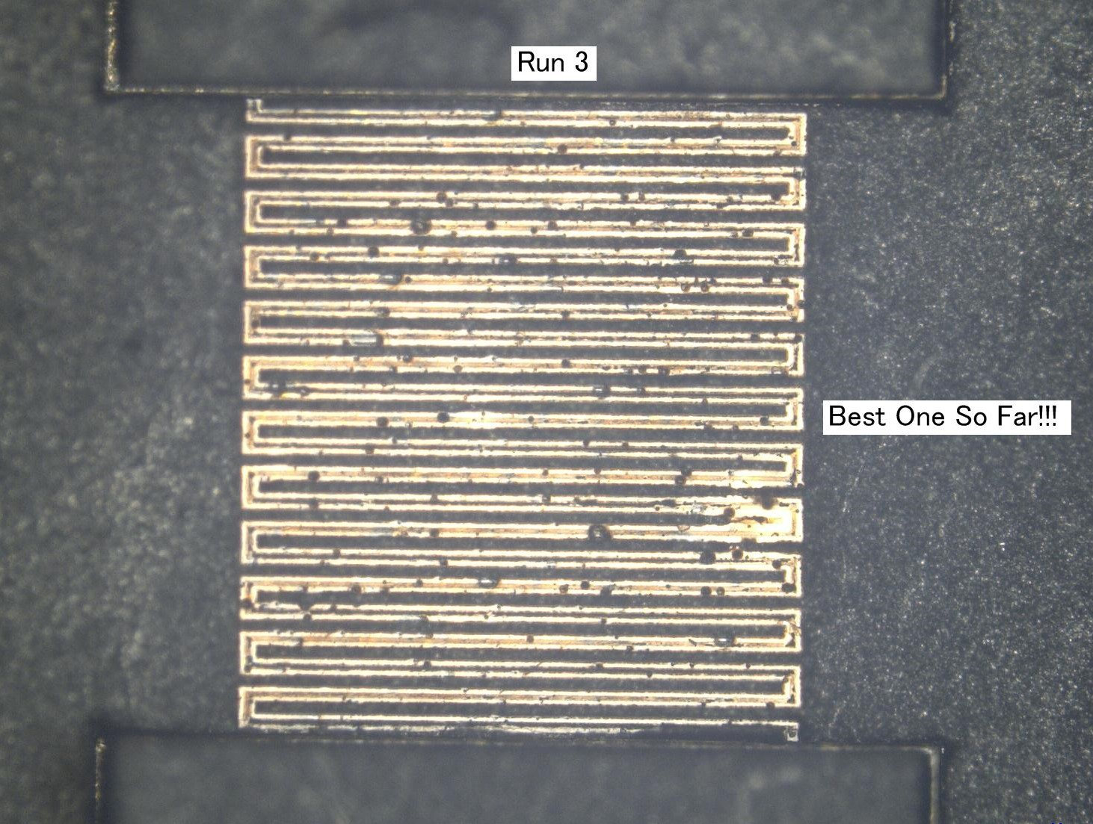
Tasks for Our Research Project!
Task 1: Use Laser to Cut the Graphene into Interdigital Pattern and Testing Under Microscope (G2, G3, O1)
Task 2: Modify Electrolyte for Optimal Conductivity in Micro-supercapacitor (G2, G3, O1)
Notes:
John says these quickly…

Slide 18
Task 1: Laser Cutting of Graphene and Testing
Interdigital Milling
Under Microscope
Laser Micro-machining System
Notes:
… leading into Task 1…

Slide 19
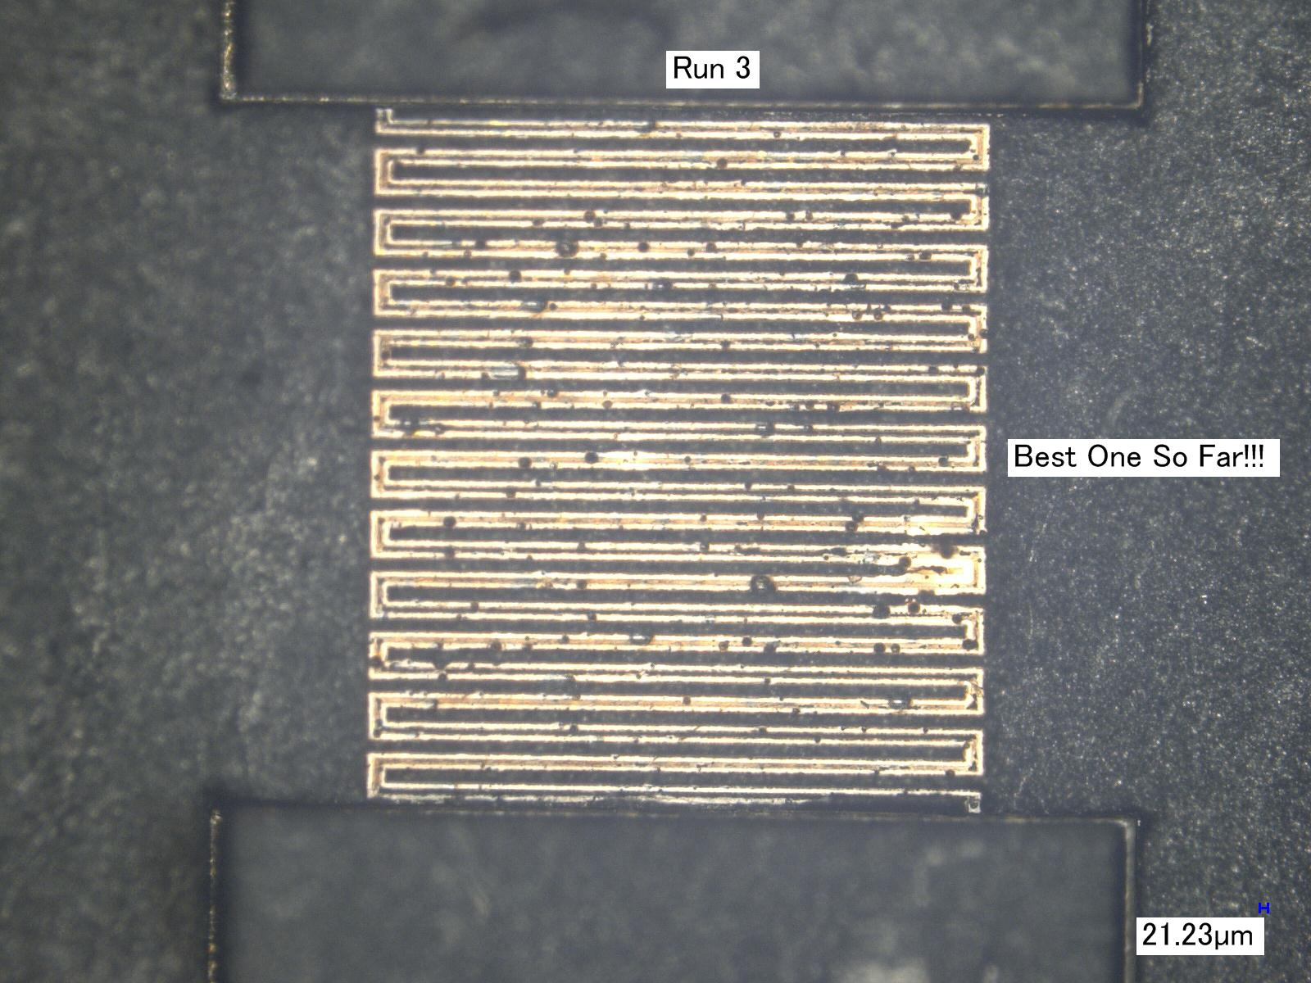
Task 1(cont'd): Laser Cutting of Graphene and Testing
Early Attempts:
Bad Milling Technique
Early attempts:
Better Milling Technique
Notes:
…continued…

Slide 20
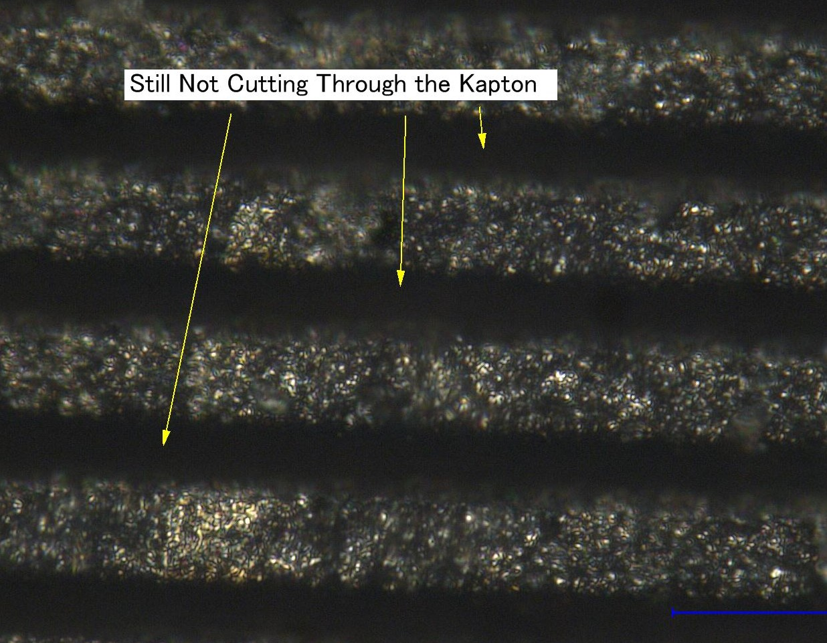
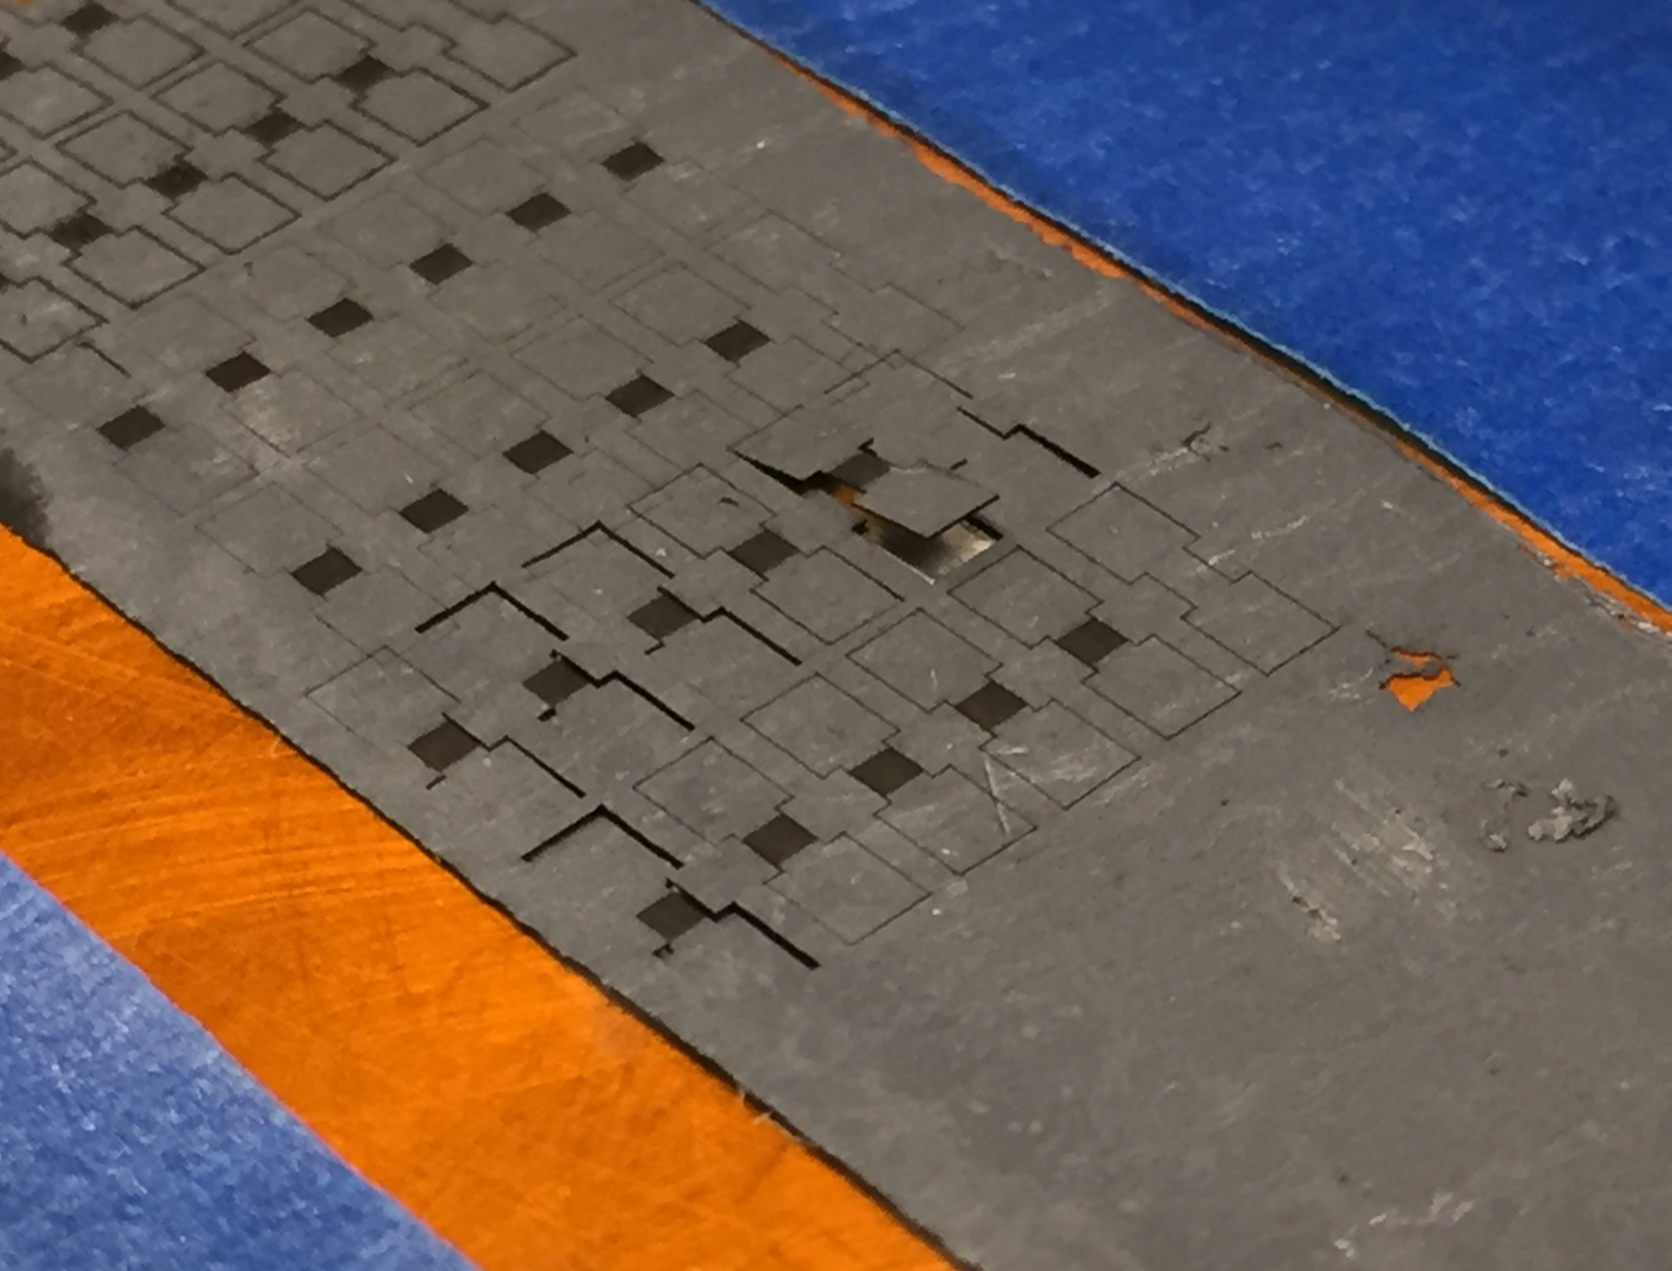
Task 1 (cont'd): Laser Cutting of Graphene and Testing
Change Milling to Cutting
Final Milling
Notes:
… continued…

Slide 21
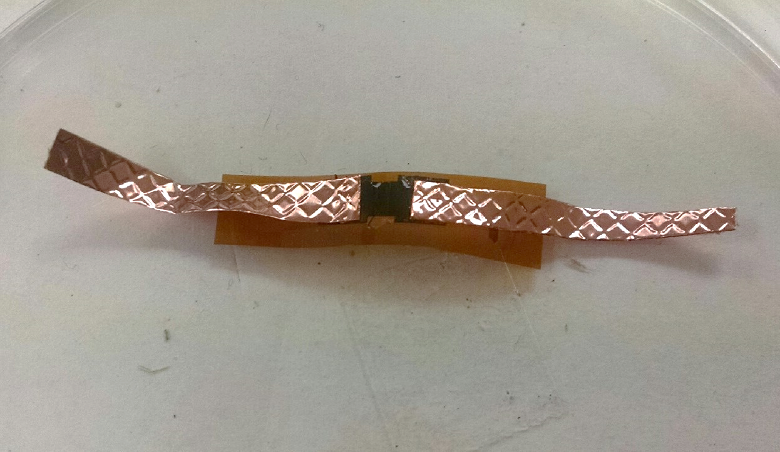
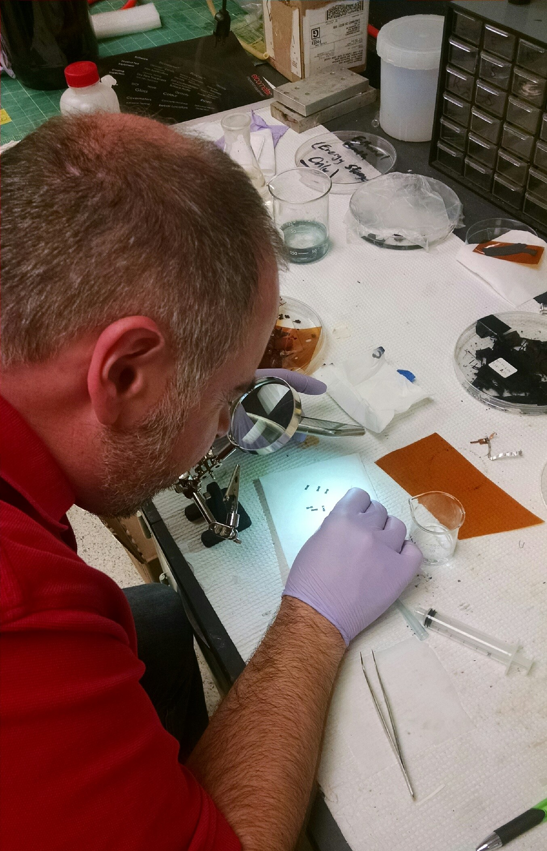
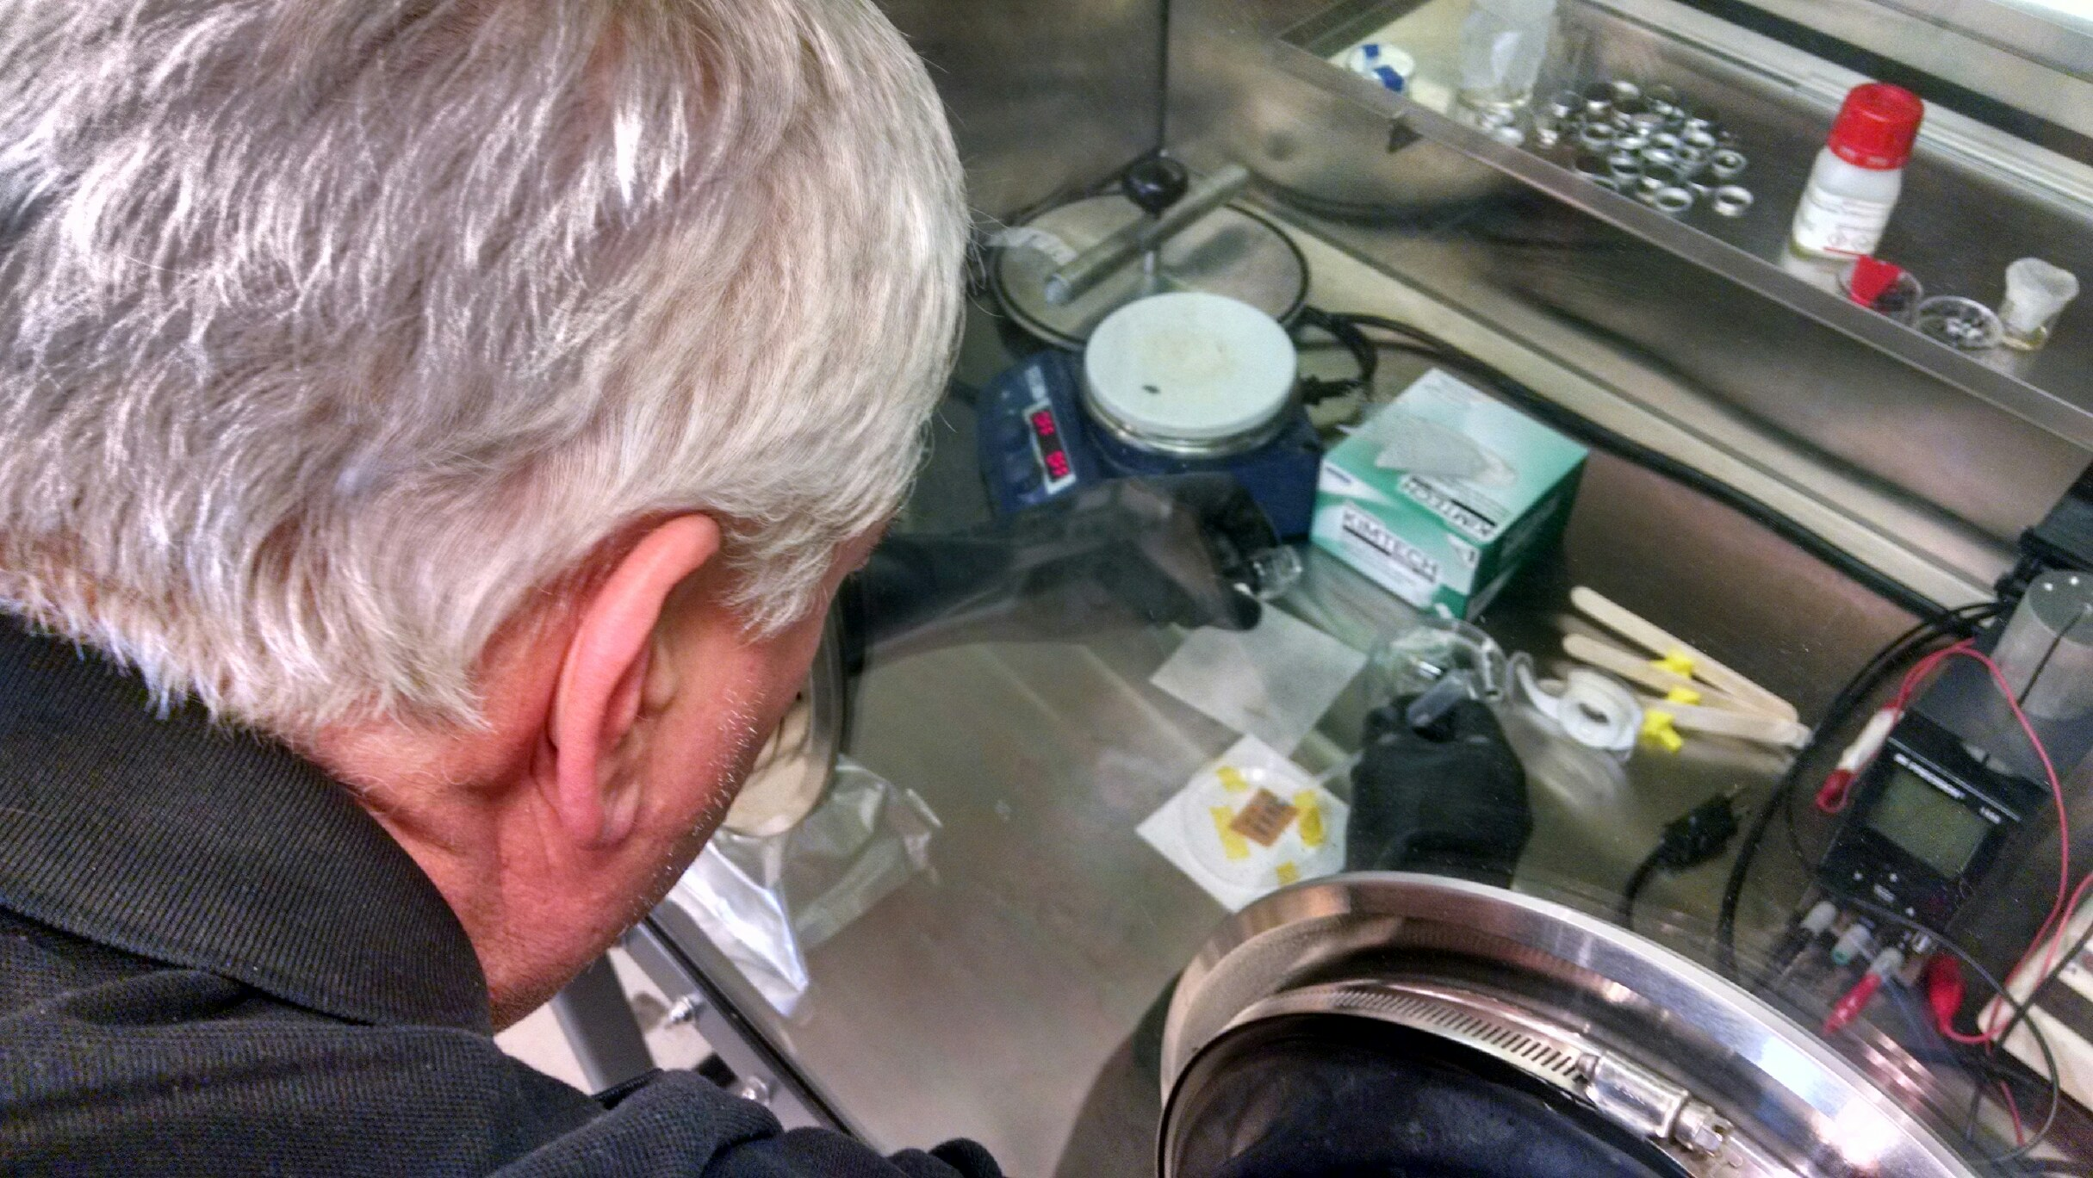
Task 2: Modify Electrolyte (G2, G3, O1)
Mike Applies EMIMBF₄ Electrolyte
John Applies PVA Electrolyte
Final Product Micro-supercapacitor
Notes:
Mike handles Task 2 BUILD SLIDE!!!

Slide 22
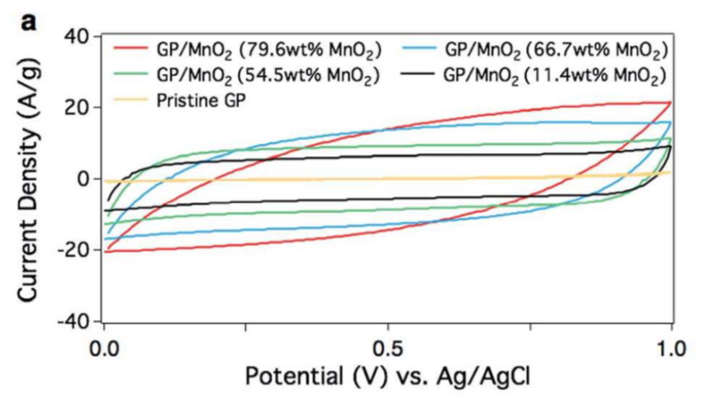
Was Our Research Successful?
Cyclic Voltammetry

Slide 23
Was Our Research Successful? Task 1: Etching
Bad Sample
Good Sample
Notes:
Build slide… John

Slide 24
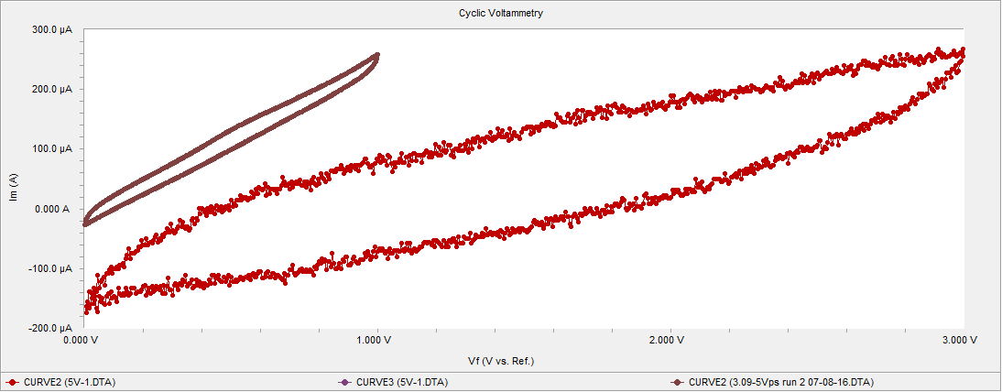
Was Our Research Successful? Task 2: Adding Electrolyte
Notes:
Note that little loop is PVA and maxes out at 1 V where big loop is EMIMBF₄ and maxes out at 3 V.

Slide 25
Did We Meet Our Goals?
In-lab Research​
Manufacture 3-D Graphene
Micro-supercapacitor
Improve Performance​
Develop Our Units​​
☑
☑
☑
☑
Notes:
Build… John

Slide 26
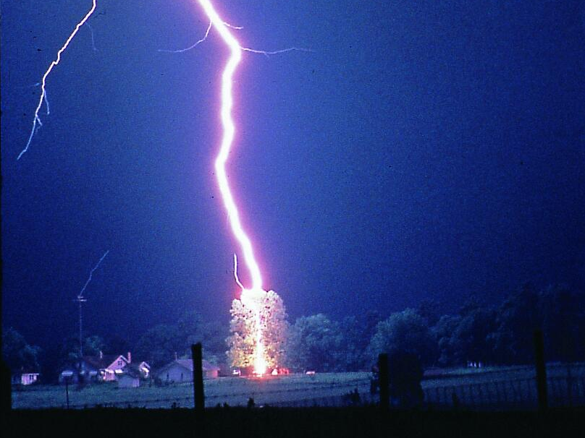
John’s Unit 1 (G4, O3)
Big Idea: Electric Power and Energy Usage
Essential Question: What Are Ways of Storing Electricity?
Notes:
John talks a bunch

Slide 27
John’s Unit
Challenge: “Amazing Race” Timed Set of Events with an Electric Toy Car
Multiple Tasks
Charging Time Included
(Amazing Race Wiki, 2016)
Notes:
John talks a bunch

Slide 28
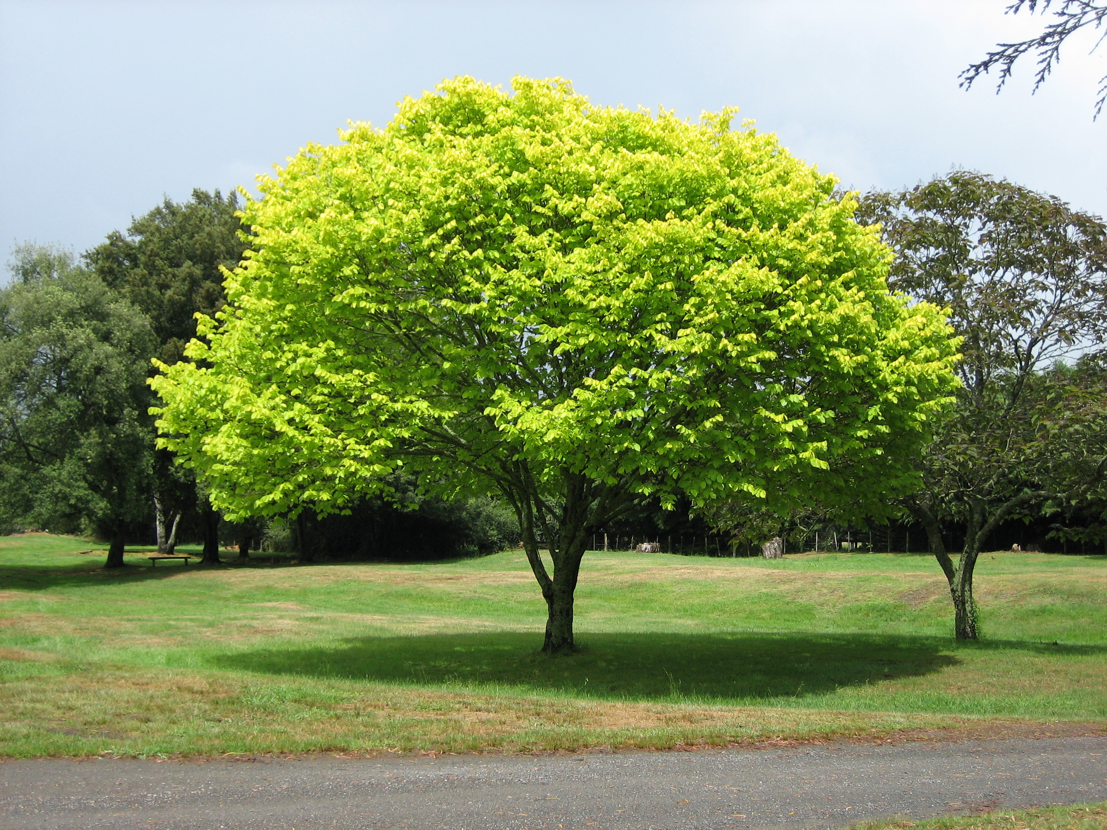
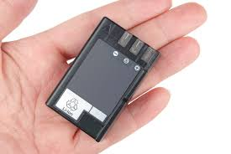
Mike's Unit 1 (G4, O3)
Big Idea: Machines that Use Energy
Essential Question: How to Make Energy Storage Devices Work More Efficiently
www.chaplingonet.org
www,rdmaq.com
Notes:
Mike talks a bunch

Slide 29
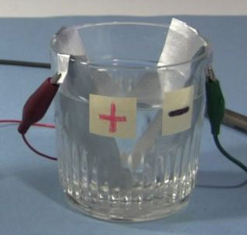
Mike's Unit
Challenge: Build a Capacitor That Charges the Fastest from a 9-volt Battery, and Discharges the Slowest, While Running a Fan
www.rimstar.org
Notes:
Mike talks a bunch

Slide 30
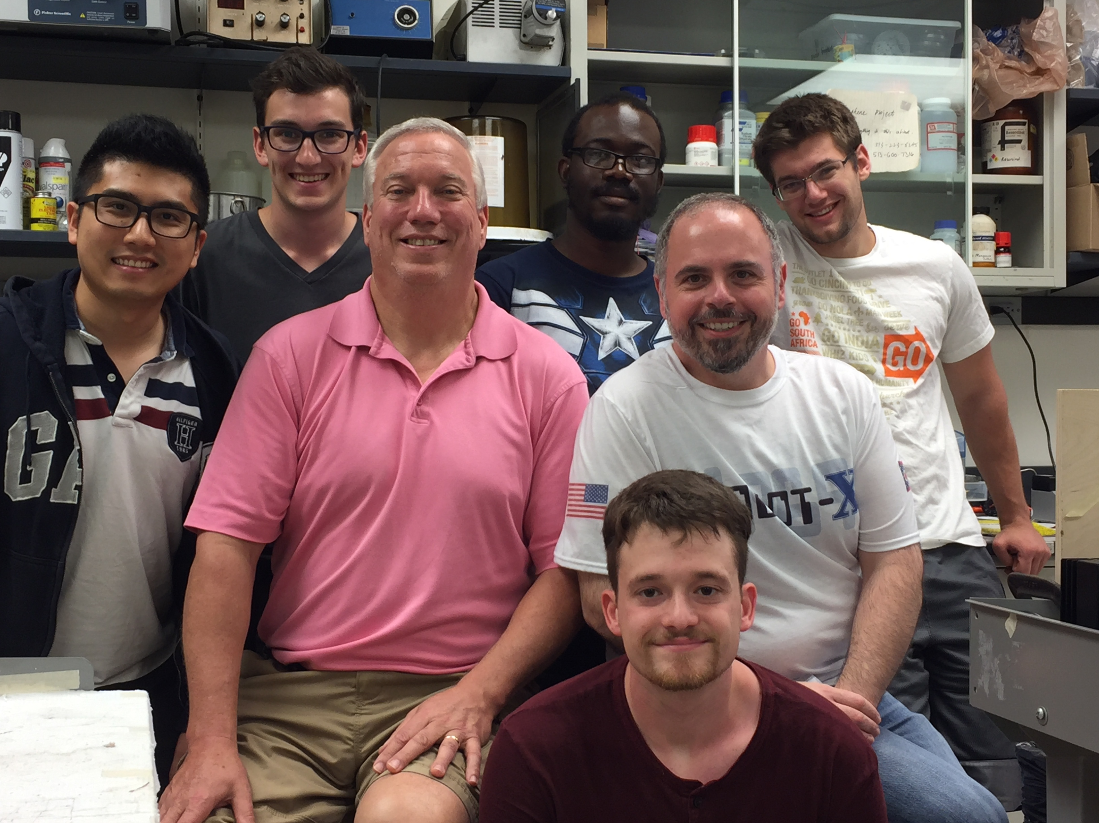
Progress Made
Task | Week 1 | Week 2 | Week 3 | Week 4 | Week 5 | Week 6 | Week 7
Literature Review
Design Experiment
Training Experiment
Conduct Experiment
Research Report
Notes:
Mike

Slide 31
Bibliography
Anonymous (2016). "Amazing Race Wiki.“ http://amazingrace.wikia.com/wiki/Main_Page (06/27, 2016).
Anonymous (2016). “Potato Battery Pictures.” http://3.bp.blogspot.com/-OuQesjhpEI8/TilMoJgA12I/AAAAAAAAJRk/V0qz3kimBFI/s1600/potato_battery_pics_06.jpg (6/28,2016)
Balakrishnan, A., and Subramanian, K. R. V. (2014). Nanostructured Ceramic Oxides for Supercapacitor. CRC Press, Boca Raton, FL.
J. Lendino. (2016). "How USB charging works, or how to avoid blowing up your smartphone." http://www.extremetech.com/computing/115251-how-usb-charging-works-or-how-to-avoid-blowing-up-your-smartphone (06/24, 2061).

Slide 32
Bibliography (Continued…)
Simon, P., Gogotsi, Y., and Dunn, B. (2014). "Where Do Batteries End and Supercapacitors Begin?" Science, 343(6176), 1210-1211.
Zhang, L., Alvarez, N. T., Zhang, M., Haase, M., Malik, R., Mast, D., and Shanov, V. (2015). "Preparation and characterization of graphene paper for electromagnetic interference shielding." Carbon, 82 353-359.
Zhang, L., DeArmond, D., Alvarez, N. T., Zhao, D., Wang, T., Hou, G., Malik, R., Heineman, W. R., and Shanov, V. (2016). "Beyond graphene foam, a new form of three-dimensional graphene for supercapacitor electrodes." Journal of Materials Chemistry A, 4(5), 1876-1886.

Slide 33
RET is funded by the National Science Foundation, grant # EEC-1404766.
We would like to acknowledge the hard work and support of our Faculty Mentor, Dr. Vesselin Shanov; Graduate Research Assistant, Lu Zhang; Other members of our research team, PK Adusei, James Bruneman, Derek Dearmond, and Nathaniel Tiffany; RET Resource Person & Grant Coordinator, Debbie Liberi; RET Project Director and Principal Investigator, Dr. Anant Kukreti; RET Resource Teacher, David Macmorine; the Reading Board of Education; and the St. Xavier Board of Trustees.
Notes:
Leave this showing

